Slide 1
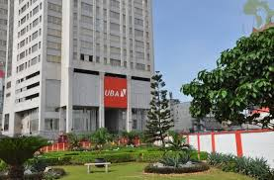
GROUP PRESENTATION FOR
BAM 2102 ENTREPRENEURSHIP

Slide 2
UBA BANK
INTRODUCTION
ORGANISATION PROSPECTS
United Bank for Africa (UBA) Group is one of Africa’s leading financial institutions offering banking services to more than seven million customers via
750 branches in 18 African countries.
UBA commenced its operations in May 2008, starting with the opening of the main branch on Kampala-Jinja Highway

Slide 3
FORCES AFFECTING ORGANISATIONAL PROSPECTS
INTERNAL FORCES
This simply refers to conditions within an organization that tend to affect the organizational operations and the organization board has full control over these factors.
Innovativeness of top managers
Motivation of employees from top managers.
Discrimination when recruiting new workers.
Nature of the organization
The kind of working relationship between the top managers and the employees of the bank

Slide 4
FORCES AFFECTING ORGANISATIONAL PROSPECTS
EXTERNAL FORCES
UBA has external factors that affect its operations, some of these factors may be from competing organizations, governmental influence and many more.
Economic Forces
Technological Forces
Political/Legal Forces
Taxation policy
Demographic forces of the environment
Market forces
Socio cultural factor
NOTE: UBA has less control over these factors.

Slide 5
INTERNAL FORCES
Innovativeness of top managers
Top managers will be able to introduce distinctive ideas that will separate the bank from the rest of the banks hence there will be an increase in the number of customers
Working relationship between employees
Good attitudes towards work
Motivated to work hard.
Employees will be able to express their ideas freely.

Slide 6
INTERNAL FORCES
Motivation of employees
Promotion of workers
Salary increments
Allowances
Good working conditions
Discrimination when recruiting new workers.
Favoritism
Giving a job to some one you want even if the person is not qualified for the job

Slide 7

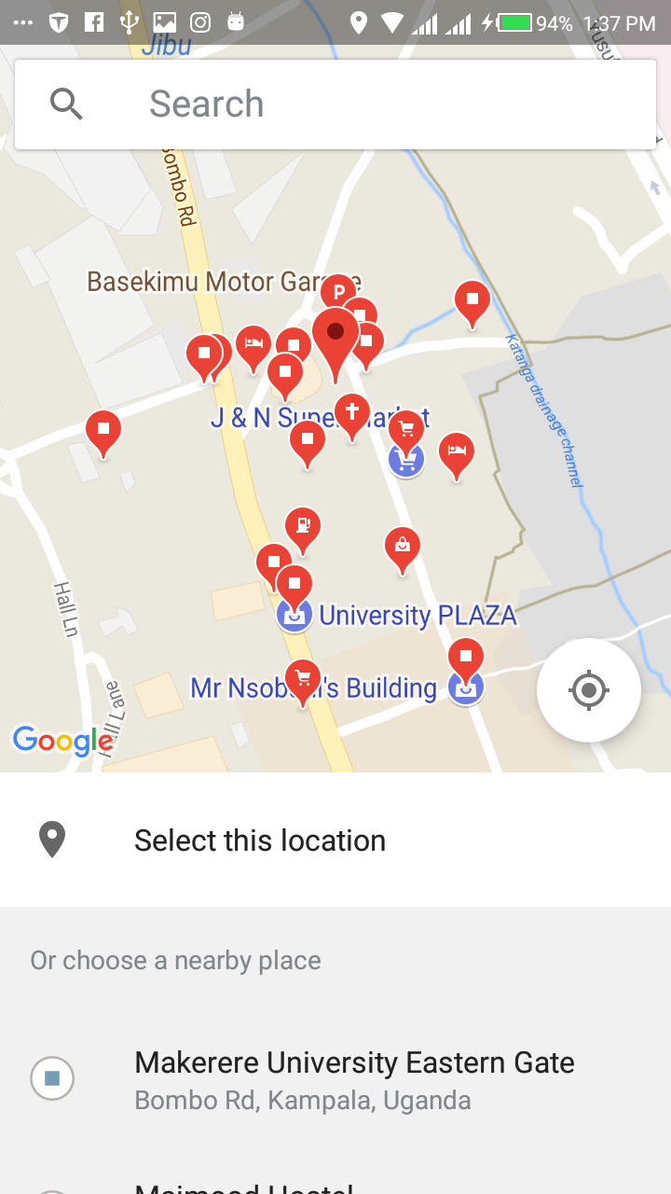

INTERFACES Schedule task Add location Select location

Slide 8
THE END

